Slide 1
Classification : Performance Metrics

Slide 2
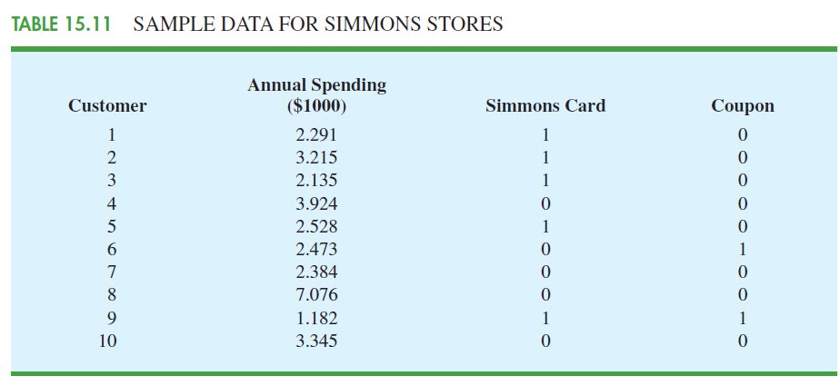
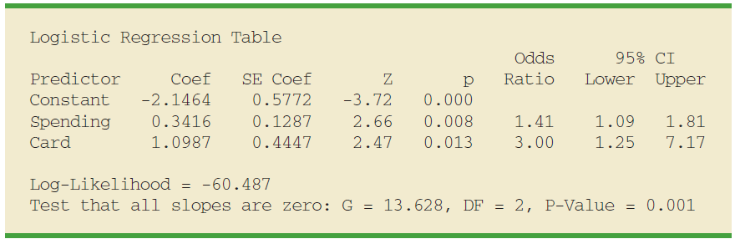
Review Logistic Regression

Slide 3
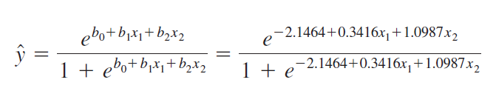
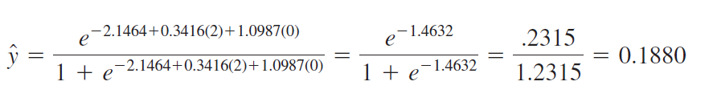
Questions
Estimate the probability of using the coupon for customers who spend $2000 annually and do not have a Simmons credit card,

Slide 4
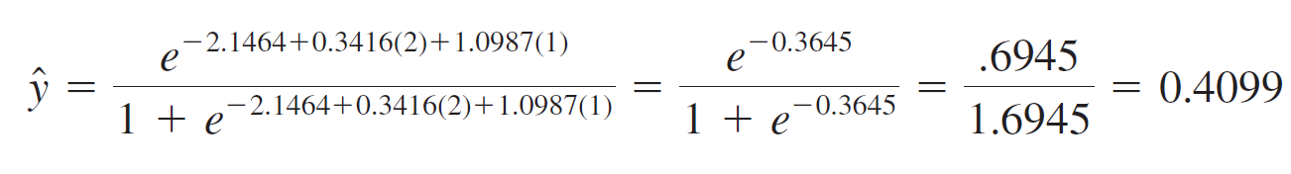
Questions
Estimate the probability of using the coupon for customers who spend $2000 annually and have a Simmons credit card,

Slide 5
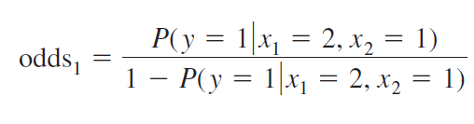
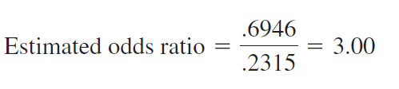
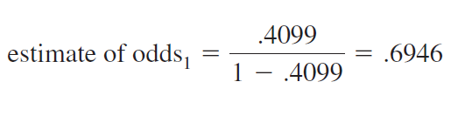
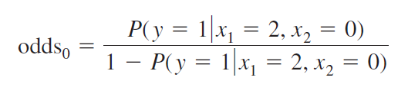
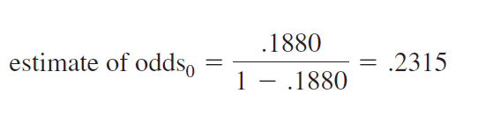
Questions
conclude that the estimated odds in favour of using the coupon for customers who spent $2000 last year and have a Simmons credit card are 3 times greater than the estimated odds in favour of using the coupon for customers who spent $2000 last year and do
not have a Simmons credit card

Slide 6
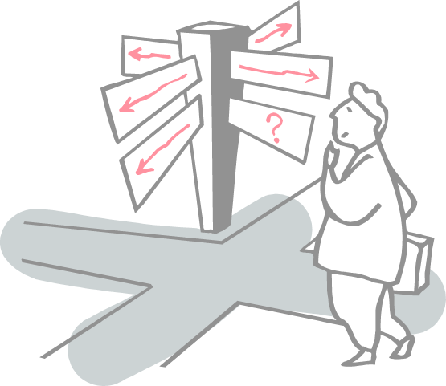
Roadmap
What do you mean by performance?
Confusion Matrix
Accuracy
Precision
Recall or Sensitivity
Specificity
F1 Score
AUC Under the ROC

Slide 7
What do you mean by performance?
After doing the usual Feature Engineering, Selection, and of course, implementing a model and getting some output in forms of a probability or a class
Next step is to find out how effective is the model based on some metric using test datasets
Different performance metrics are used to evaluate different Machine Learning Algorithms

Slide 8
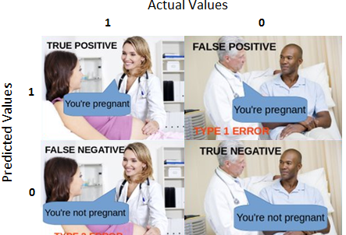
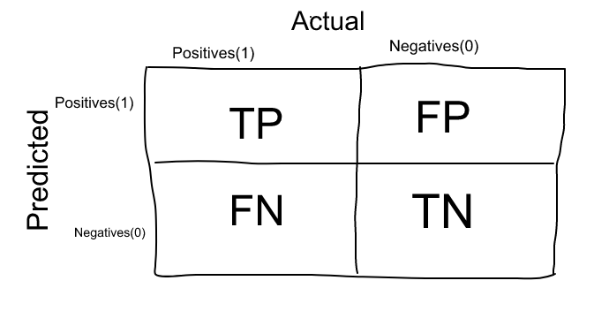
Confusion Matrix
Confusion Matrix as the name suggests gives us a matrix as output and describes the complete performance of the model.
It is used for Classification problem where the output can be of two or more types of classes.
Consider a classification problem where we are predicting whether a person is having cancer or not.
Let’s give a label of to our target variable:
1: When a person is having cancer
0: When a person is NOT having cancer.
In Confusion Matrix, Our Actual classifications are columns and Predicted ones are Rows.

Slide 9
Confusion Matrix
False Positives (FP): False positives are the cases when the actual class of the data point was 0(False) and the predicted is 1(True). False is because the model has predicted incorrectly and positive because the class predicted was a positive one. (1)
Ex: A person NOT having cancer and the model classifying his case as cancer comes under False Positives.
False Negatives (FN): False negatives are the cases when the actual class of the data point was 1(True) and the predicted is 0(False). False is because the model has predicted incorrectly and negative because the class predicted was a negative one. (0)
Ex: A person having cancer and the model classifying his case as No-cancer comes under False Negatives.
True Positives (TP): True positives are the cases when the actual class of the data point was 1(True) and the predicted is also 1(True)
Ex: The case where a person is actually having cancer(1) and the model classifying his case as cancer(1) comes under True positive.
True Negatives (TN): True negatives are the cases when the actual class of the data point was 0(False) and the predicted is also 0(False
Ex: The case where a person NOT having cancer and the model classifying his case as Not cancer comes under True Negatives.
What is an ideal scenario ?

Slide 10
When to minimise what?
No hard rule that says what should be minimised in all the situations
Depends on the business needs and the context of the problem you are trying to solve

Slide 11
When to minimise what?
No hard rule that says what should be minimised in all the situations
Depends on the business needs and the context of the problem you are trying to solve
Minimising False Negatives - Type II Error
Consider an cancer detection problem example, out of 100 people, only 5 people have cancer- 95% accuracy
When the person actually NOT having cancer is classified as Cancerous- might be okay as it is less dangerous than NOT identifying/capturing a cancerous patient
Missing a cancer patient will be a huge mistake as no further examination will be done on them
Minimising False Positives - Type I Error
Let’s assign a label to the target variable and say,1: “Email is a spam” and 0:”Email is not a spam”
That important email that you are desperately waiting for, as Spam(case of False positive)
In this situation, this is pretty bad than classifying a spam email as important or not spam since in that case, we can still go ahead and manually delete it
Spam email classification, minimising False positives is more important than False Negatives.

Slide 12
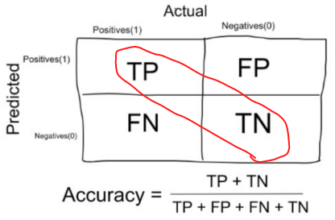
Accuracy
When to use Accuracy:
The target variable classes in the data are nearly balanced.
Ex:60% classes in our fruits images data are apple and 40% are oranges.
A model which predicts whether a new image is Apple or an Orange, 97% of times correctly is a very good measure in this example
The number of correct predictions made by the model over all kinds predictions made
When NOT to use Accuracy:
Accuracy should NEVER be used as a measure when the target variable classes in the data are a majority of one class.
Ex: In our cancer detection example with 100 people, only 5 people has cancer.
Let’s say our model is very bad and predicts every case as No Cancer. In doing so, it has classified those 95 non-cancer patients correctly and 5 cancerous patients as Non-cancerous.

Slide 13
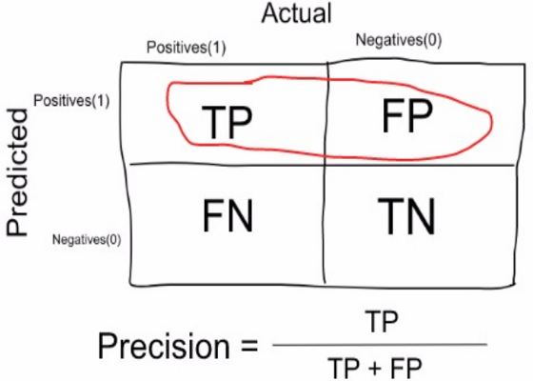
Precision
It is the number of correct positive results divided by the number of positive results predicted by the classifier
Precision is a measure that tells us what proportion of patients that we diagnosed as having cancer, actually had cancer
The predicted positives (People predicted as cancerous are TP and FP) and the people actually having a cancer are TP.
Ex: In our cancer example with 100 people, only 5 people have cancer. Let’s say our model is very bad and predicts every case as Cancer.
Since we are predicting everyone as having cancer, our denominator(True positives and False Positives) is 100 and the numerator, person having cancer and the model predicting his case as cancer is 5.
So in this example, we can say that Precision of such model is 5%.

Slide 14
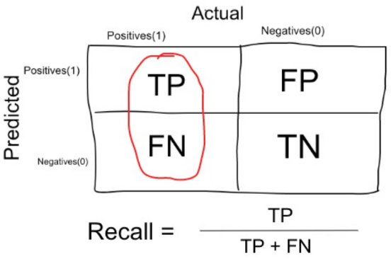
Recall or Sensitivity
True Positive Rate corresponds to the proportion of positive data points that are correctly considered as positive, with respect to all positive data points.
Recall is a measure that tells us what proportion of patients that actually had cancer was diagnosed by the algorithm as having cancer.
The actual positives (People having cancer are TP and FN) and the people diagnosed by the model having a cancer are TP.
In our cancer example with 100 people, 5 people actually have cancer. Let’s say that the model predicts every case as cancer
So our denominator(True positives and False Negatives) is 5 and the numerator, person having cancer and the model predicting his case as cancer is also 5(Since we predicted 5 cancer cases correctly).
So in this example, we can say that the Recall of such model is 100%.

Slide 15
When to use Precision and When to use Recall?
Precision gives us information about its performance with respect to false positives(how many did we caught)
If we want to focus on minimising False positives, then our focus should be to make Precision as close to 100% as possible
Recall gives us information about a classifier’s performance with respect to false negatives (how many did we miss)
Focus more on minimising False Negatives, we would want our Recall to be as close to 100% as possible

Slide 16
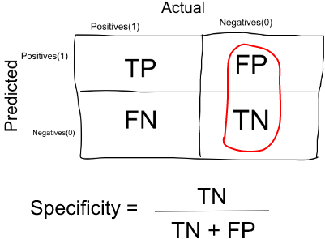
Specificity
Specificity is a measure that tells us what proportion of patients that did NOT have cancer, were predicted by the model as non-cancerous.
The actual negatives (People actually NOT having cancer are FP and TN) and the people diagnosed by us not having cancer are TN.
Specificity is the exact opposite of Recall.
False Positive Rate corresponds to the proportion of negative data points that are mistakenly considered as positive, with respect to all negative data points
In our cancer example with 100 people, 5 people actually have cancer. Let’s say that the model predicts every case as cancer.
So our denominator(False positives and True Negatives) is 95 and the numerator, person not having cancer and the model predicting his case as no cancer is 0 (Since we predicted every case as cancer).
So Specificity of such model is 0%.

Slide 17
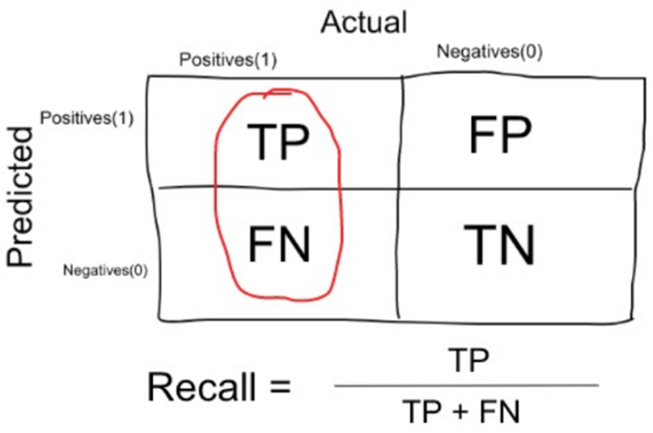
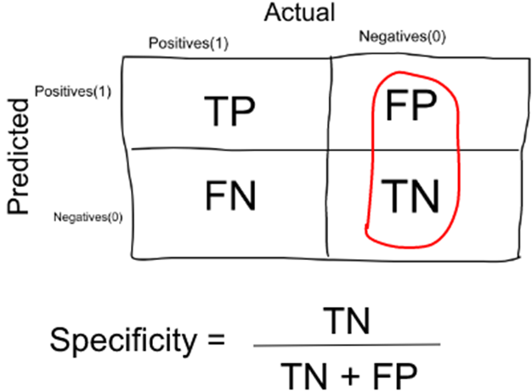
Sensitivity (Recall) Vs Specificity
Sensitivity measure is used to determine the proportion of actual positive cases, which got predicted correctly.
Specificity measure is used to determine the proportion of actual negative cases, which got predicted correctly

Slide 18
More Examples
Aa random sample of 500 female, teenage customers. Of these teenagers, 50 actually are pregnant. Model predicted 100 total pregnant teenagers, 45 of which are actually pregnant.

Slide 19
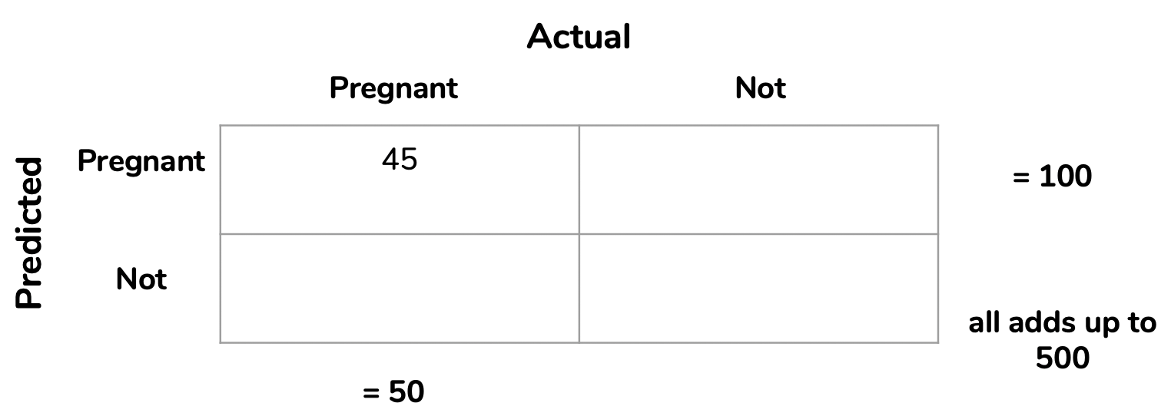
More Examples
Aa random sample of 500 female, teenage customers. Of these teenagers, 50 actually are pregnant. model predicted 100 total pregnant teenagers, 45 of which are actually pregnant.

Slide 20
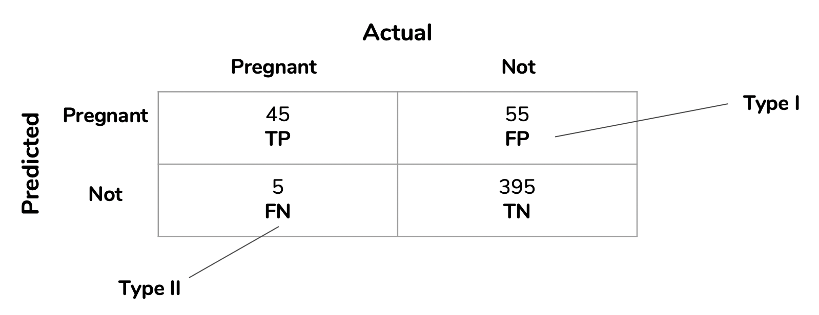
More Examples

Slide 21
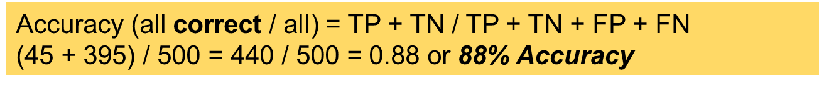
More Examples

Slide 22
More Examples
Precision (true positives / predicted positives) = TP / TP + FP
45 / (45 + 55) = 45 / 100 = 0.45 or 45% Precision

Slide 23
More Examples
Sensitivity/Recall (true positives / all actual positives) = TP / TP + FN
45 / (45 + 5) = 45 / 50 = 0.90 or 90% Sensitivity

Slide 25
More Examples
Specificity (true negatives / all actual negatives) =TN / TN + FP
395 / (395 + 55) = 395 / 450 = 0.88 or 88% Specificity

Slide 26
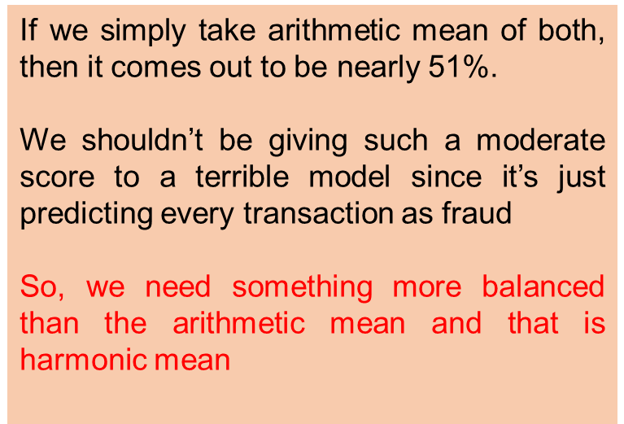
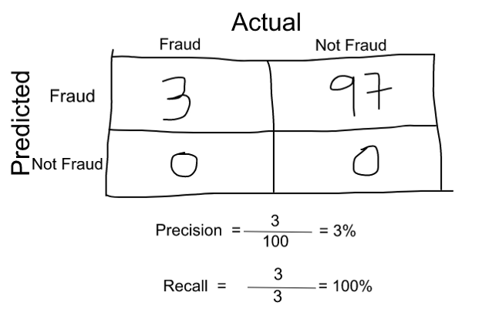
F1 Score
A single score that kind of represents both Precision(P) and Recall(R).
One way to do that is simply taking their arithmetic mean. i.e (P + R) / 2 where P is Precision and R is Recall. But that’s pretty bad in some situations.
Suppose we have 100 credit card transactions, of which 97 are legit and 3 are fraud and let’s say we came up a model that predicts everything as fraud.

Slide 27
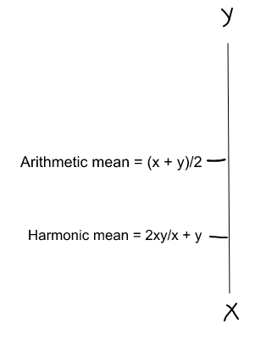
F1 Score
Harmonic mean is kind of an average when x and y are equal. But when x and y are different, then it’s closer to the smaller number as compared to the larger number
F1 Score = Harmonic Mean(Precision, Recall)
F1 Score = 2 * Precision * Recall / (Precision + Recall) = 2*3*100/103 = 5%
So if one number is really small between precision and recall, the F1 Score kind of raises a flag and is more closer to the smaller number than the bigger one, giving the model an appropriate score rather than just an arithmetic mean

Slide 28
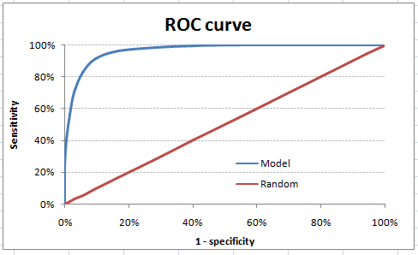

Area Under the ROC(Receiver operating characteristic)
The ROC curve is the plot between sensitivity and (1- specificity).
(1- specificity) is also known as false positive rate and sensitivity is also known as True Positive rate.
Sensitivity : +ve Recall – Out of all +ve samples , how many sample was my classifier able to picks up (TPR)
Specificity: -ve Recall – Out of all -ve samples , how many sample was my classifier able to picks up
1- specificity = FPR

Slide 29
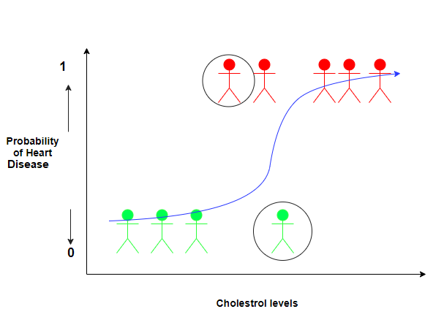
Area Under the ROC – Example

Slide 30
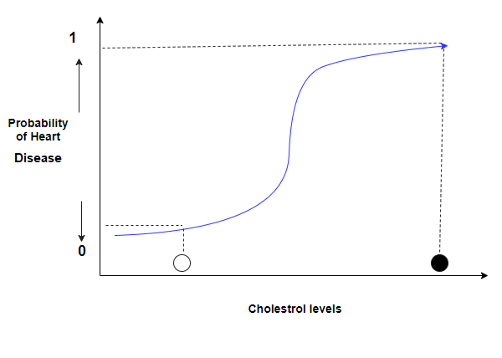
Area Under the ROC – Example

Slide 31
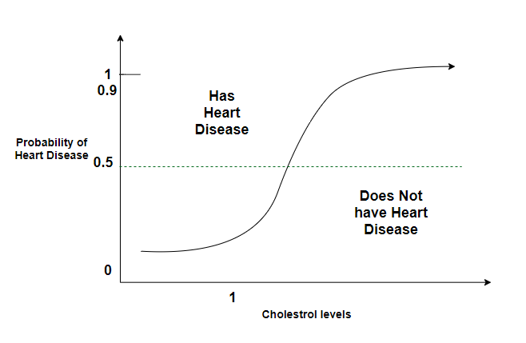
Area Under the ROC – Example

Slide 32
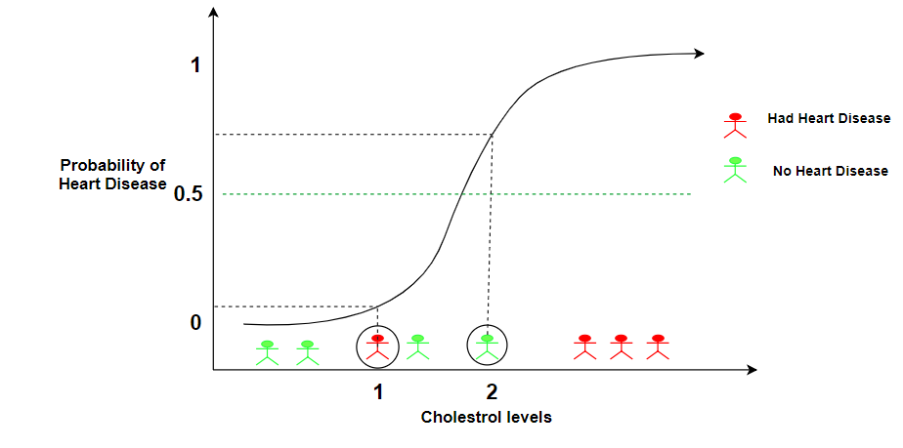
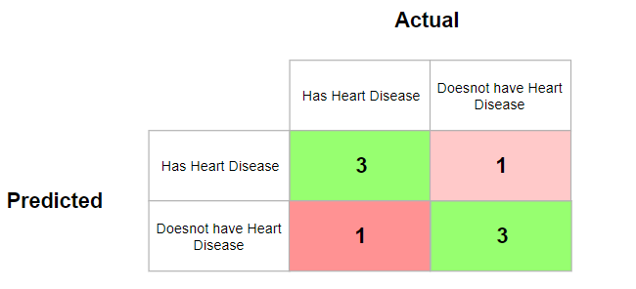
Area Under the ROC – Example

Slide 33
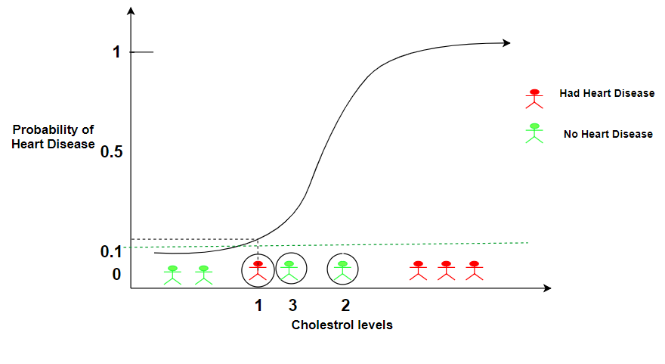
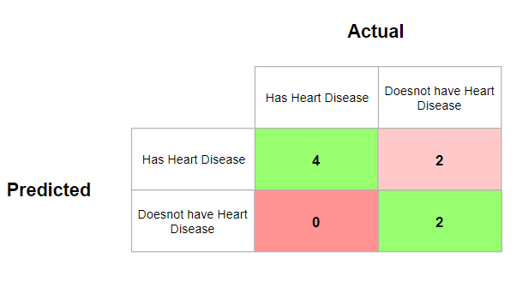
Area Under the ROC – Example- Setting the Threshold to 0.1

Slide 34
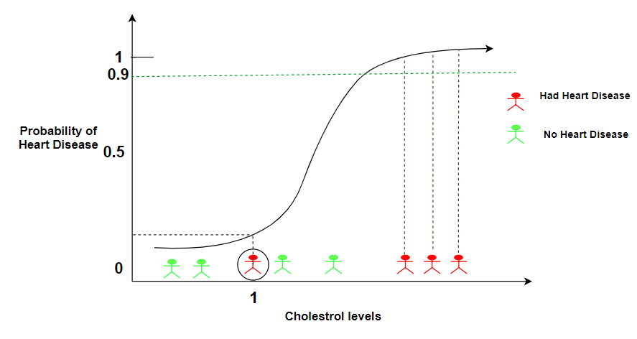
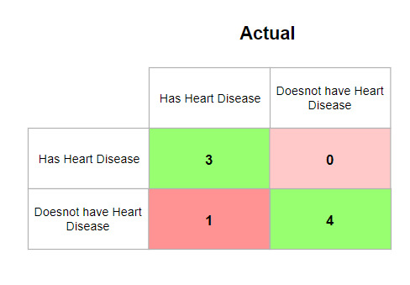
Area Under the ROC – Example- Setting the Threshold to 0.9

Slide 35
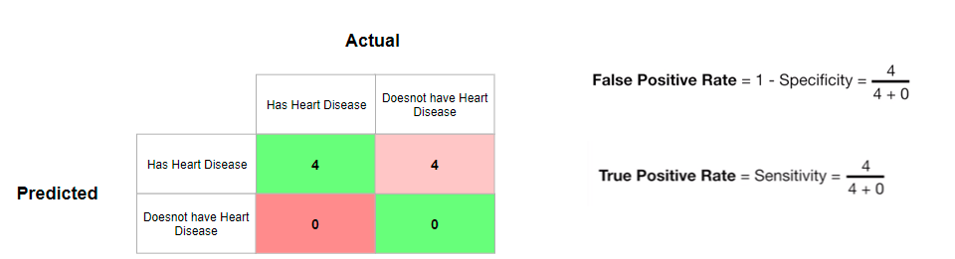
Area Under the ROC – Example
ROC(Receiver Operator Characteristic Curve) can help in deciding the best threshold value. It is generated by plotting the True Positive Rate (y-axis) against the False Positive Rate (x-axis)
Threshold classifying all people as having heart disease

Slide 36
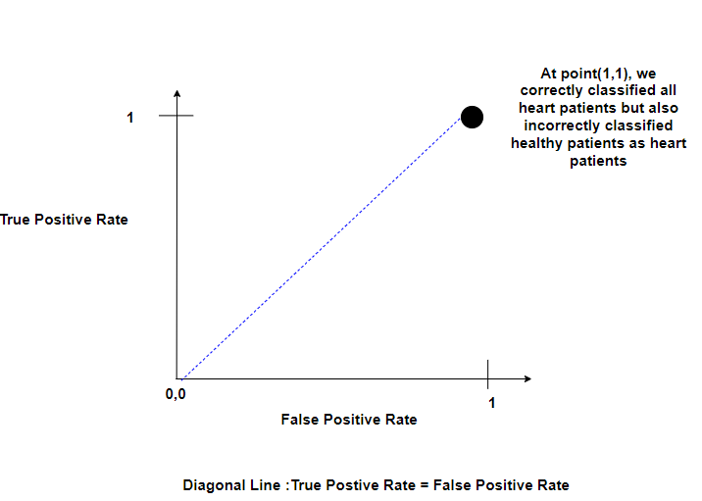
Area Under the ROC – Example
Threshold classifying all people as having heart disease

Slide 37
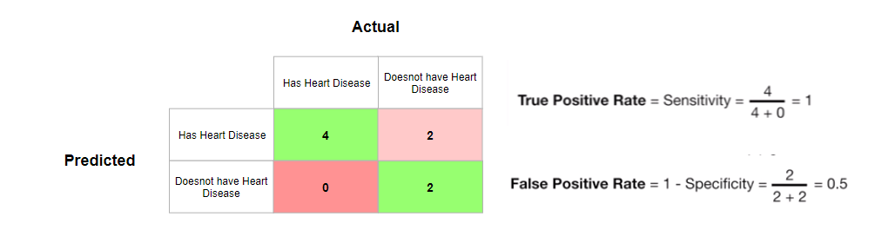
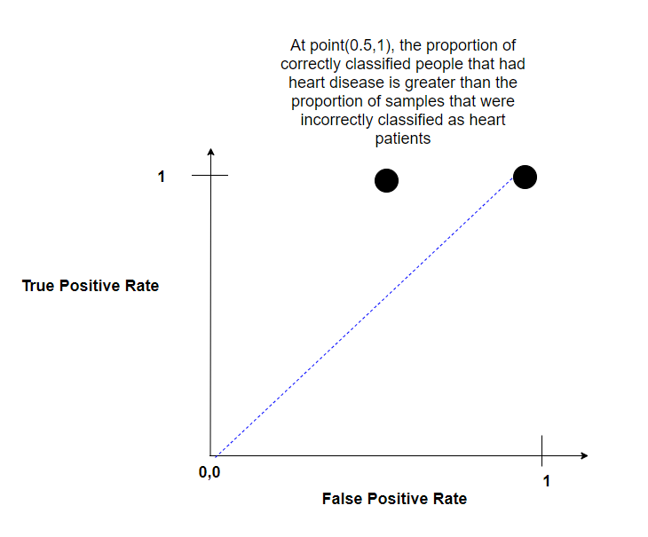
Increasing the Threshold slightly so that only the two people with the least cholesterol value are below the threshold

Slide 38
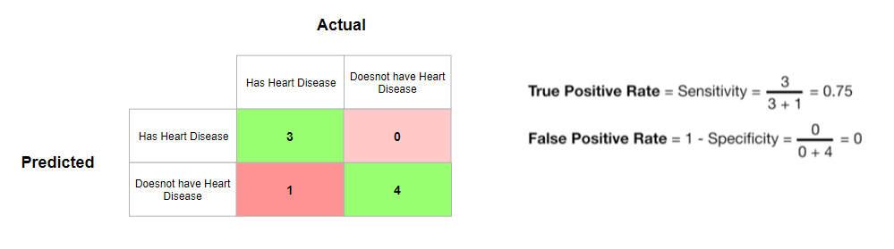
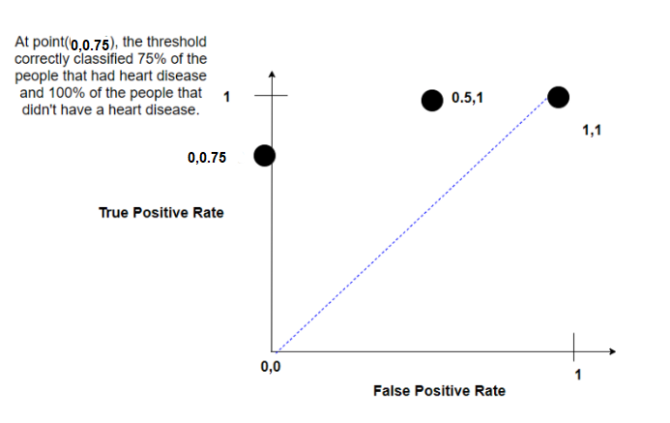
Increasing the threshold values

Slide 39
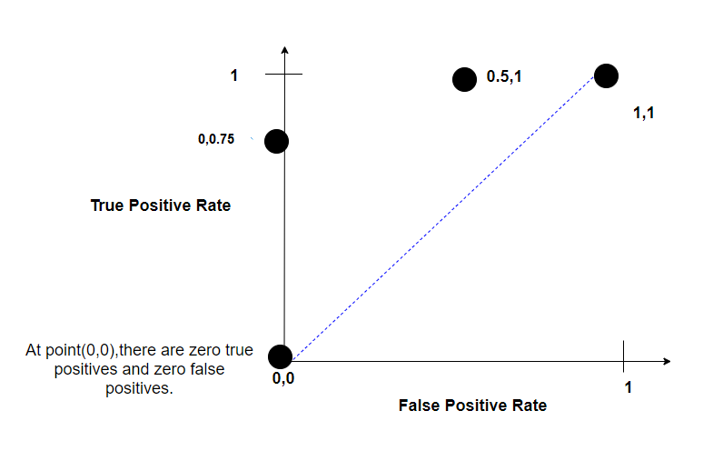
Lastly, we choose a threshold where we classify all people as not having a heart disease i.e Threshold of 1

Slide 40
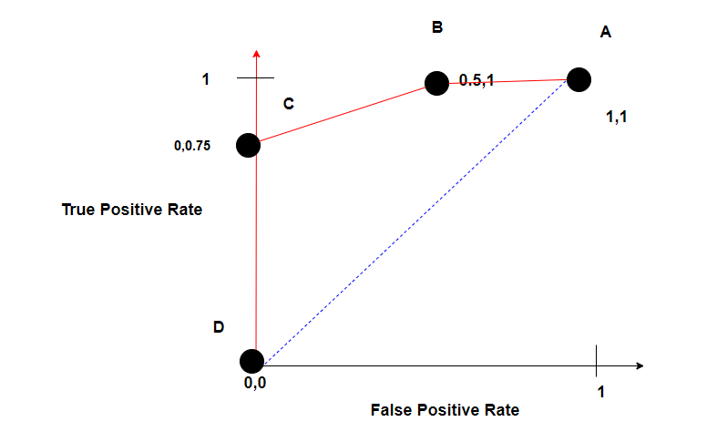
ROC

Slide 41
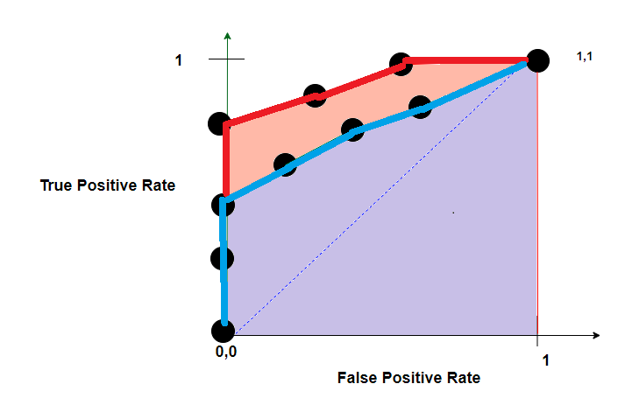
AUC

Slide 42
Area Under the ROC(Receiver operating characteristic) Example
Y_{a} | Y_{p} | Y₀ | Y_{0.2} | Y_{0.4} | Y_{0.6} | Y_{0.8} | Y_{1.0}
1 | 0.8 | 1 | 1 | 1 | 1 | 1 | 0
0 | 0.6 | 1 | 1 | 1 | 1 | 0 | 0
1 | 0.4 | 1 | 1 | 1 | 0 | 0 | 0
0 | 0.2 | 1 | 1 | 0 | 0 | 0 | 0
TPR | TP/(FN + TP) | 2/(0 +2) = 1 | 2/(0 +2) = 1 | 2/(2+0) = 1 | 1/(1+1) =0 .5 | 1/(1+1) =0 .5 | 0/(2+0) = 0
FPR | FP/(TN + FP) | 2/(0+2) = 1 | 2/(0+2) = 1 | 1/(1+1) =0 .5 | 1/(1+1) =0 .5 | 0/(2+0) = 0 | 0/(2+0) = 0

Slide 43
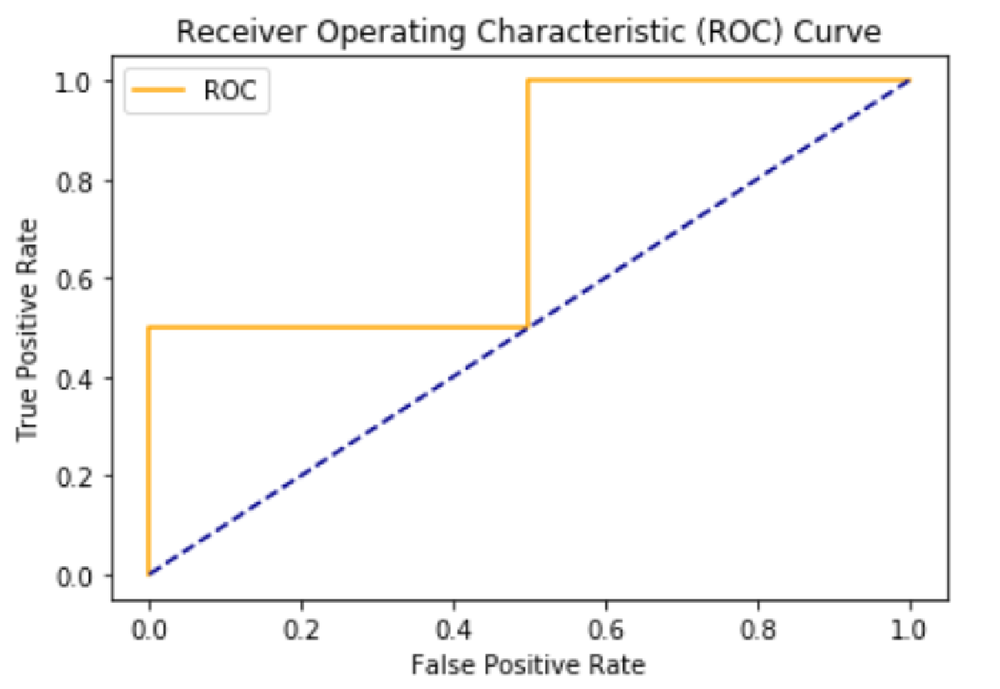
Area Under the ROC(Receiver operating characteristic) Example
Area Under Curve value never go under = 0.5
Total AUC in this example = 0.5 + .25 = 0.75
Choosing a threshold depends on the business need ☺

Slide 44
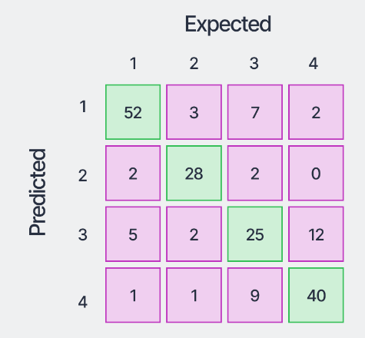
Confusion Matrix for Multiple Classes

Slide 45
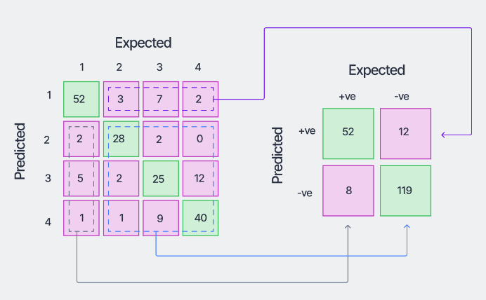
Confusion Matrix for Multiple Classes

Slide 46
Confusion Matrix for Multiple Classes – C1

Slide 47
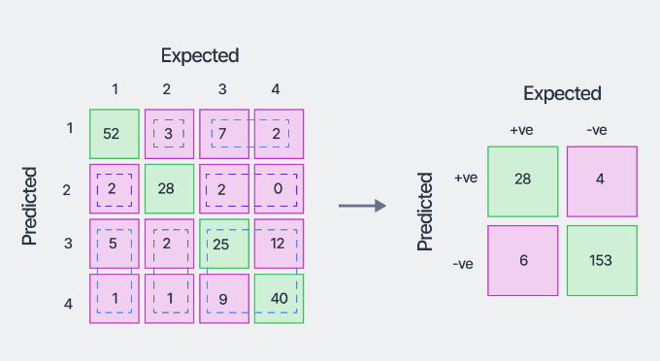
Confusion Matrix for Multiple Classes

Slide 48
Confusion Matrix for Multiple Classes – C2

Slide 49
References
https://medium.com/thalus-ai/performance-metrics-for-classification-problems-in-machine-learning-part-i-b085d432082b
https://becominghuman.ai/understand-classification-performance-metrics-cad56f2da3aa
https://towardsdatascience.com/metrics-to-evaluate-your-machine-learning-algorithm-f10ba6e38234
https://www.youtube.com/watch?v=mUMd_cKU0VM
https://towardsdatascience.com/understanding-the-roc-and-auc-curves-a05b68550b69
https://www.v7labs.com/blog/confusion-matrix-guide
https://www.analyticsvidhya.com/blog/2021/06/confusion-matrix-for-multi-class-classification/

